Slide 1

CST 8244 Real Time Programming
Winter 2012
Instructor: Saif Terai
 727 4723 ext 3467, Room: T322
Email: terais@algonquincollege.com

Slide 2
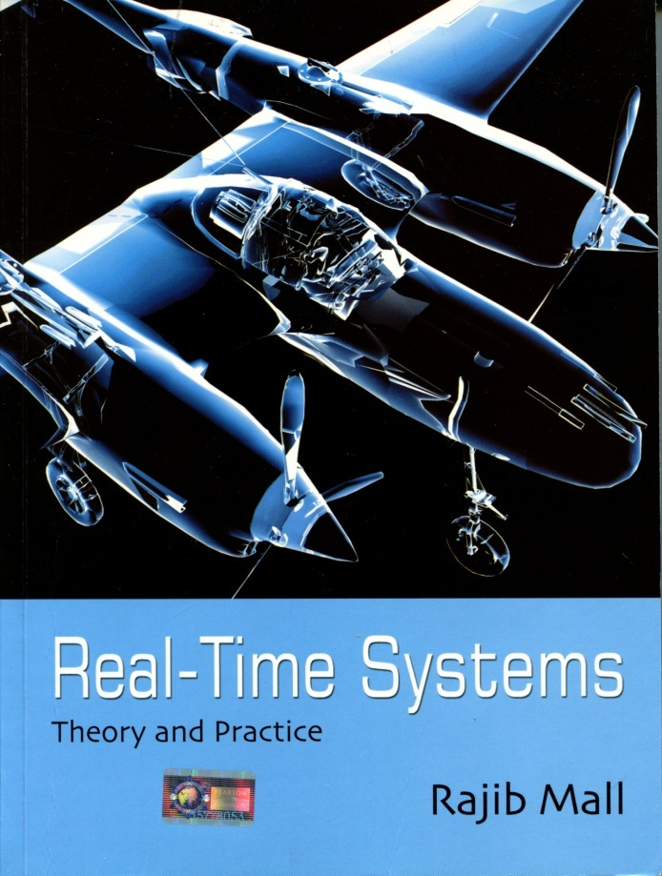
Textbook
Real-Time Systems Theory and Practice,
by Rajib Mall
ISBN: 978-81-317-0069-3
Publisher: Pearson Education
You may buy it.
Book is available on Safari Database.

Slide 3
Learning Resources
QNX Training Material
Getting Started with QNX Neutrino: A Guide for Realtime Programmers by Rob Krten. Online copy from QNX Help
See Learning Resources in Course Outline

Slide 4
Textbook
Questions
Should I buy the book?
How much of the text we will refer to?
Answers
Book is a required learning resource. Reading assignments refer to required book
Questions is quizzes, tests and final exam are from the book
If online reading is convenient to you, refer to Safari Database.

Slide 5
Course Information
You must demonstrate your labs and assignment in class for your mark to be updated
DO NOT schedule your project technical presentation or any other project related tasks during the class hours
Avoid completing assignments for other courses and term project during Real Time lecture and lab
1 hr 40 minutes each time we meet is roughly divided into 50 minutes lecture and 50 minutes lab.
On some occasions the proportion may change.

Slide 6
Evaluation
Tests – 30%
Final Exam – 30%
Assignments – 20%
In Class Lab Exercises – 10%
Online Participation – 10%

Slide 7
To pass the course you must
write final exam
get minimum 50% on tests and exams combined
get a minimum of 50% on assignments and group work
complete and submit all assignments and presentations
not miss more than three labs

Slide 8
Office Hours
Monday to Thursday 10:00 am to 5:00 pm
My Winter 2012 schedule is posted in Blackboard
When I am not in a lecture or lab, you can come in when I am in the office
Send me and email to schedule a meeting

Slide 9
Test Dates & Due Dates
Tests
Test 1, Week 5, Wednesday 8 February 2012
Test 2, Week 12, Wednesday 4 April 2012
Held during regular lecture/lab hours
Assignments
Assignment 1, due Week 6, Friday 17 February 2012
Assignment 2 due Week 13, Friday 13 April 2012

Slide 10
Labs
Install VM Ware, Neutrino 6.50 runs as a target on VM Ware
QNX Momentics IDE runs on Mac OS and Win, connects with Neutrino. You need a DHCP service

Slide 11
Course Overview
Real Time System (RT) Definition
Defining of hard, soft, or firm Real-Time systems.
Definition of embedded systems and deeply embedded systems
Characteristics and examples RT systems, types of RT Systems
Define the relationship between an event and latency
Examine security issues and potential solutions with Real Time Operating systems (RTOS)

Slide 12
Application Development
Architecture of the QNX Neutrino Operating System
Relationship between process manager and scheduler
Priority system of process management used in QNX Neutrino
Scheduling algorithms used in the QNX Neutrino OS
QNX Neutrino in a virtual machine and QNX Momentics IDE, based on Eclipse, for file management, source code creation, compiling and linking application programs

Slide 13
Application Development
Use QNX Momentics to check file status, process, program and system status
Define Process, Thread and their relationship.
Inter Process Communication (IPC) messages as applied in QNX Neutrino
Mutex and semaphore
Differentiate between POSIX and non-POSIX functions in QNX Neutrino

Slide 14
IPC
Process creation using the exec, spawn, system and fork
Process calls and their subsets
Client/server applications, communicate IPC available in QNX Neutrino such as Messages, Pulses, Shared Memory
Timed control to perform the assigned task(s)
Scripted Real Time application to control a system which will involve sensors and switches
Develop RT systems which incorporate several elements of a RT

Slide 15
Timing and Interrupts
Concepts of interrupt driven systems
Signals or pulses to have processes or threads respond to interrupts
Service Thread
Timers in a Real Time system
Use signals or pulses to have processes or threads respond to timer timeouts
Latency in timers and interrupts
Develop a basic real time Resource Manager

